Slide 1
ATAI
Advanced Technique of Artificial Intelligence
ATAI
ChongqingUniversity _{AdvancedTechniqueof}
of Technology Artificial Intelligence
Chongqing University of
Technology
Chongqing University ^{ATAI}
_{of Technology} Advanced Techniqueof
Artificial Intelligence
Chongqing University of Technology
Chongqing University of Technology
Self-Supervised Denoising through Independent Cascade Graph
Augmentation for Robust Social Recommendation
Code : https://github.com/sunyc123r/SSD-ICGA.git
—— KDD2024
Reported by Jing Li
1

Slide 2
ATAI
Advanced Technique of Artificial Intelligence
ATAI
ChongqingUniversity _{AdvancedTechniqueof}
of Technology Artificial Intelligence
Chongqing University of
Technology
Chongqing University ^{ATAI}
_{of Technology} Advanced Techniqueof
Artificial Intelligence
Chongqing University of Technology
Chongqing University of Technology
Introduction
1、Existing solutions to alleviate social noise either filter out the noisy connections or generate new potential social connections. Due to the absence of labels, the former approaches may retain uncertain connections for user preference modeling while the latter methods may introduce additional social noise .
2、social neighbor is noisy depends not only on the node itself but also on the indirect neighbors.Social noise likely comes from the connected users with low preference similarity; and Opinion Leaders (OLs) play a pivotal role in influence dissemination,surpassing high-similarity neighbors, regardless of their preference similarity with trusting peers.

Slide 3
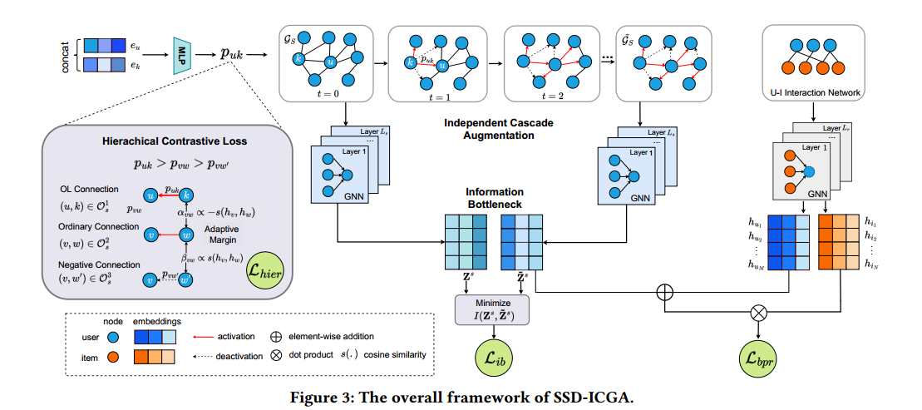
ATAI
Advanced Technique of Artificial Intelligence
ATAI
ChongqingUniversity _{AdvancedTechniqueof}
of Technology Artificial Intelligence
Chongqing University of
Technology
Chongqing University ^{ATAI}
_{of Technology} Advanced Techniqueof
Artificial Intelligence
Chongqing University of Technology
Chongqing University of Technology
Overview

Slide 4
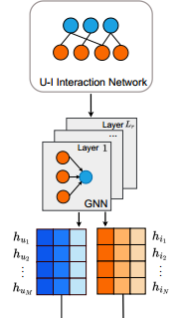
ATAI
Advanced Technique of Artificial Intelligence
ATAI
ChongqingUniversity _{AdvancedTechniqueof}
of Technology Artificial Intelligence
Chongqing University of
Technology
Chongqing University ^{ATAI}
_{of Technology} Advanced Techniqueof
Artificial Intelligence
Chongqing University of Technology
Chongqing University of Technology
Method

Slide 5
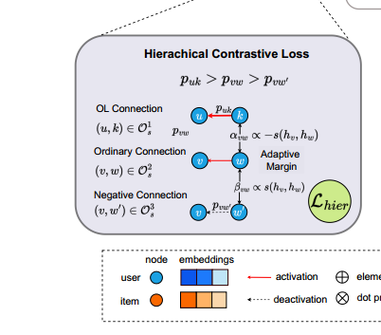
ATAI
Advanced Technique of Artificial Intelligence
ATAI
ChongqingUniversity _{AdvancedTechniqueof}
of Technology Artificial Intelligence
Chongqing University of
Technology
Chongqing University ^{ATAI}
_{of Technology} Advanced Techniqueof
Artificial Intelligence
Chongqing University of Technology
Chongqing University of Technology
Method

Slide 6
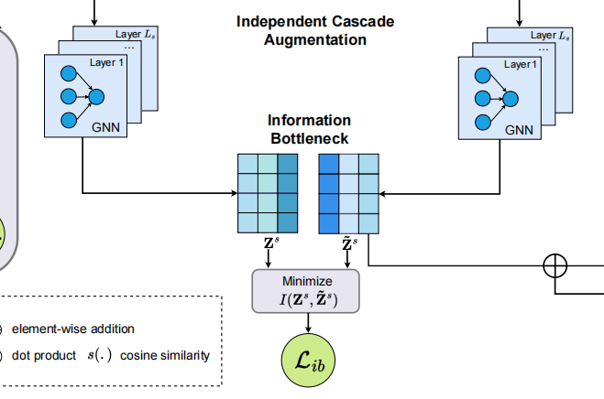
ATAI
Advanced Technique of Artificial Intelligence
ATAI
ChongqingUniversity _{AdvancedTechniqueof}
of Technology Artificial Intelligence
Chongqing University of
Technology
Chongqing University ^{ATAI}
_{of Technology} Advanced Techniqueof
Artificial Intelligence
Chongqing University of Technology
Chongqing University of Technology
Method

Slide 7
ATAI
Advanced Technique of Artificial Intelligence
ATAI
ChongqingUniversity _{AdvancedTechniqueof}
of Technology Artificial Intelligence
Chongqing University of
Technology
Chongqing University ^{ATAI}
_{of Technology} Advanced Techniqueof
Artificial Intelligence
Chongqing University of Technology
Chongqing University of Technology
Method

Slide 8
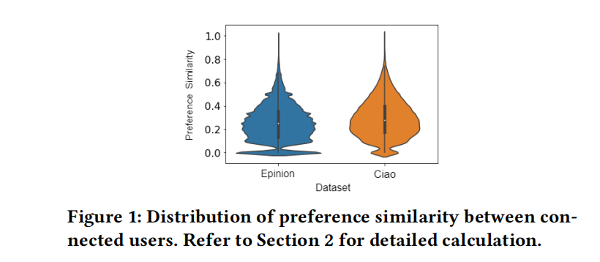
ATAI
Advanced Technique of Artificial Intelligence
ATAI
ChongqingUniversity _{AdvancedTechniqueof}
of Technology Artificial Intelligence
Chongqing University of
Technology
Chongqing University ^{ATAI}
_{of Technology} Advanced Techniqueof
Artificial Intelligence
Chongqing University of Technology
Chongqing University of Technology
Experiments

Slide 9
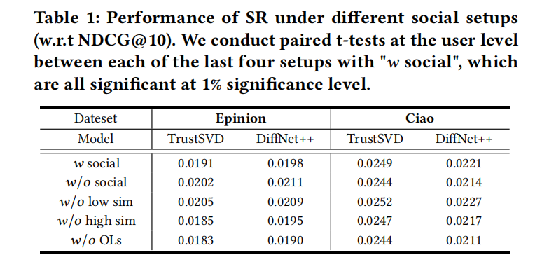
ATAI
Advanced Technique of Artificial Intelligence
ATAI
ChongqingUniversity _{AdvancedTechniqueof}
of Technology Artificial Intelligence
Chongqing University of
Technology
Chongqing University ^{ATAI}
_{of Technology} Advanced Techniqueof
Artificial Intelligence
Chongqing University of Technology
Chongqing University of Technology
Experiments

Slide 10
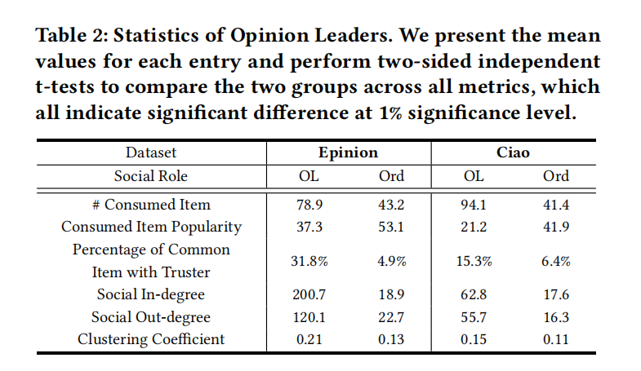
ATAI
Advanced Technique of Artificial Intelligence
ATAI
ChongqingUniversity _{AdvancedTechniqueof}
of Technology Artificial Intelligence
Chongqing University of
Technology
Chongqing University ^{ATAI}
_{of Technology} Advanced Techniqueof
Artificial Intelligence
Chongqing University of Technology
Chongqing University of Technology
Experiments

Slide 11
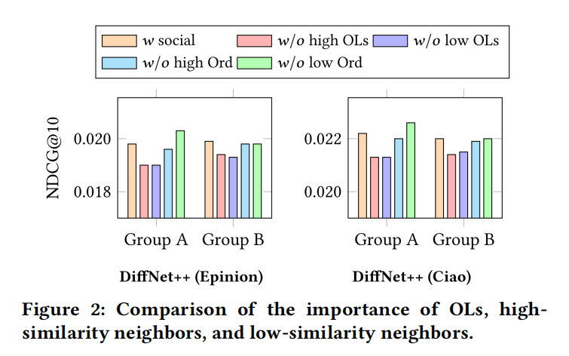
ATAI
Advanced Technique of Artificial Intelligence
ATAI
ChongqingUniversity _{AdvancedTechniqueof}
of Technology Artificial Intelligence
Chongqing University of
Technology
Chongqing University ^{ATAI}
_{of Technology} Advanced Techniqueof
Artificial Intelligence
Chongqing University of Technology
Chongqing University of Technology
Experiments

Slide 12
ATAI
Advanced Technique of Artificial Intelligence
ATAI
ChongqingUniversity _{AdvancedTechniqueof}
of Technology Artificial Intelligence
Chongqing University of
Technology
Chongqing University ^{ATAI}
_{of Technology} Advanced Techniqueof
Artificial Intelligence
Chongqing University of Technology
Chongqing University of Technology
Experiments

Slide 13
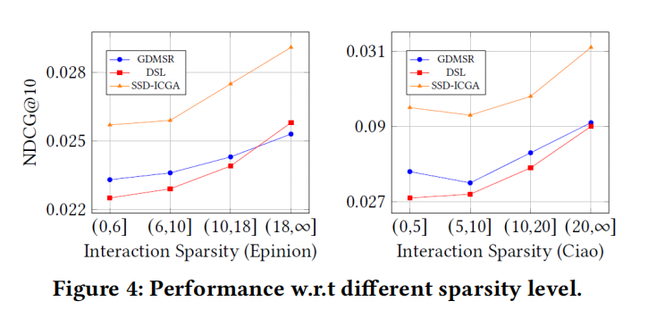
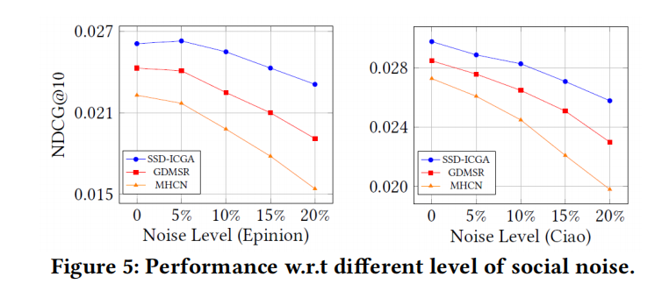
ATAI
Advanced Technique of Artificial Intelligence
ATAI
ChongqingUniversity _{AdvancedTechniqueof}
of Technology Artificial Intelligence
Chongqing University of
Technology
Chongqing University ^{ATAI}
_{of Technology} Advanced Techniqueof
Artificial Intelligence
Chongqing University of Technology
Chongqing University of Technology
Experiments

Slide 14
ATAI
Advanced Technique of Artificial Intelligence
ATAI
ChongqingUniversity _{AdvancedTechniqueof}
of Technology Artificial Intelligence
Chongqing University of
Technology
Chongqing University ^{ATAI}
_{of Technology} Advanced Techniqueof
Artificial Intelligence
Chongqing University of Technology
Chongqing University of Technology
Experiments

Slide 15
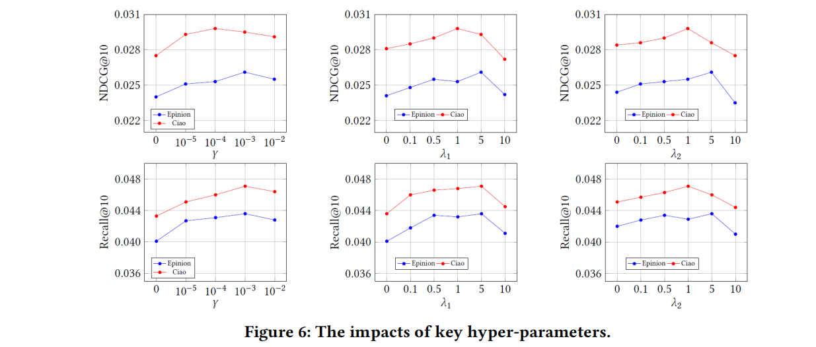
ATAI
Advanced Technique of Artificial Intelligence
ATAI
ChongqingUniversity _{AdvancedTechniqueof}
of Technology Artificial Intelligence
Chongqing University of
Technology
Chongqing University ^{ATAI}
_{of Technology} Advanced Techniqueof
Artificial Intelligence
Chongqing University of Technology
Chongqing University of Technology
Experiments

Slide 16
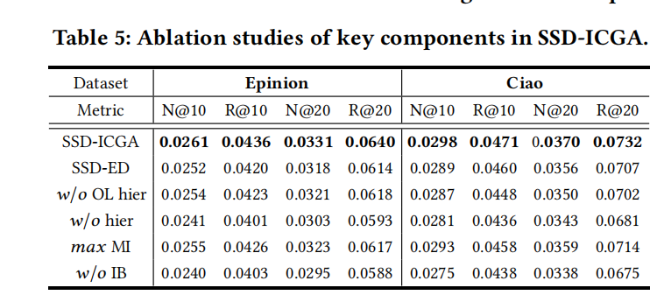
ATAI
Advanced Technique of Artificial Intelligence
ATAI
ChongqingUniversity _{AdvancedTechniqueof}
of Technology Artificial Intelligence
Chongqing University of
Technology
Chongqing University ^{ATAI}
_{of Technology} Advanced Techniqueof
Artificial Intelligence
Chongqing University of Technology
Chongqing University of Technology
Experiments

Slide 17
ATAI
Advanced Technique of Artificial Intelligence
ATAI
ChongqingUniversity _{AdvancedTechniqueof}
of Technology Artificial Intelligence
Chongqing University of
Technology
Chongqing University ^{ATAI}
_{of Technology} Advanced Techniqueof
Artificial Intelligence
Chongqing University of Technology
Chongqing University of Technology
Experiments

Slide 18
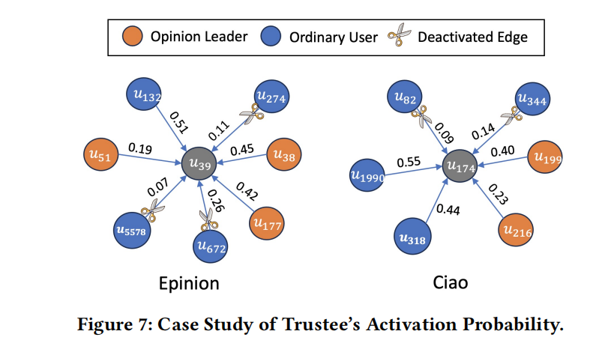
ATAI
Advanced Technique of Artificial Intelligence
ATAI
ChongqingUniversity _{AdvancedTechniqueof}
of Technology Artificial Intelligence
Chongqing University of
Technology
Chongqing University ^{ATAI}
_{of Technology} Advanced Techniqueof
Artificial Intelligence
Chongqing University of Technology
Chongqing University of Technology
Experiments

Slide 19
ATAI
Advanced Technique of Artificial Intelligence
ATAI
ChongqingUniversity _{AdvancedTechniqueof}
of Technology Artificial Intelligence
Chongqing University of
Technology
Chongqing University ^{ATAI}
_{of Technology} Advanced Techniqueof
Artificial Intelligence
Chongqing University of Technology
Chongqing University of Technology
Thanks!

